Slide 1

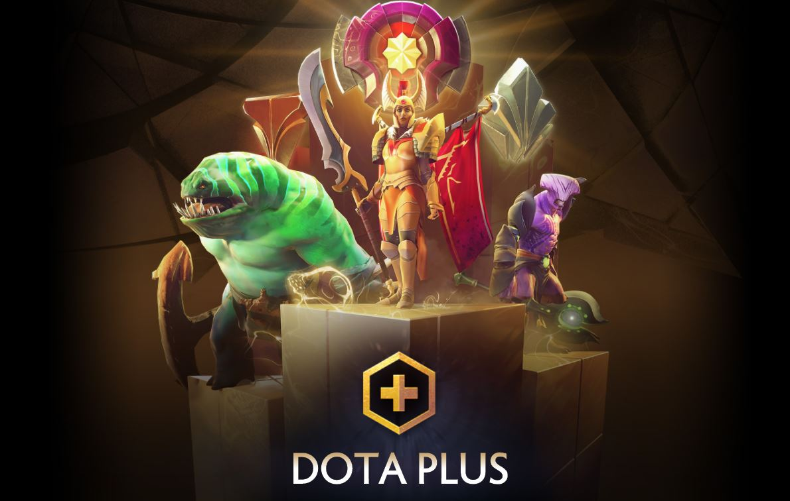

PLUS
Jarvin Bayona
Notes:
Hello everybody, thank you for coming today. I am going to be talking about a video game called Dota 2 and the predictor for it.

Slide 2
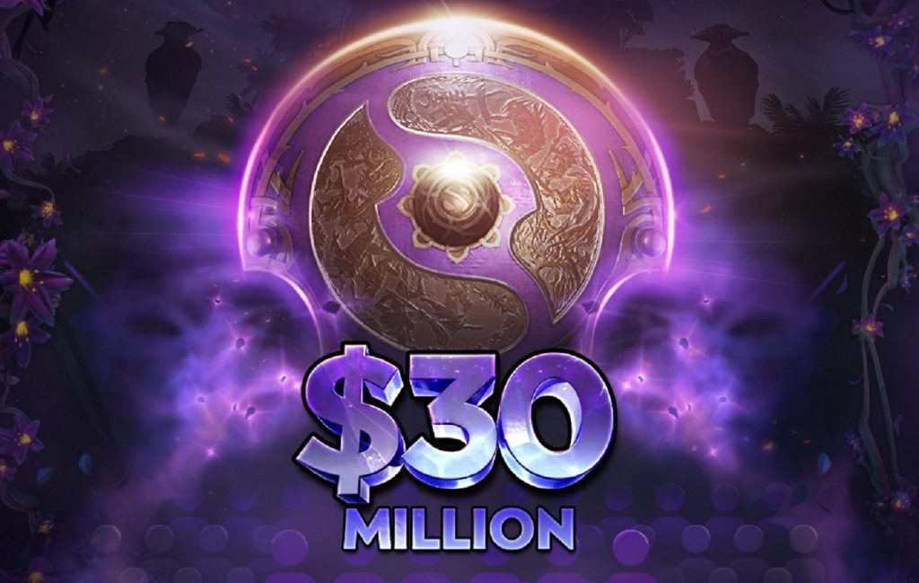
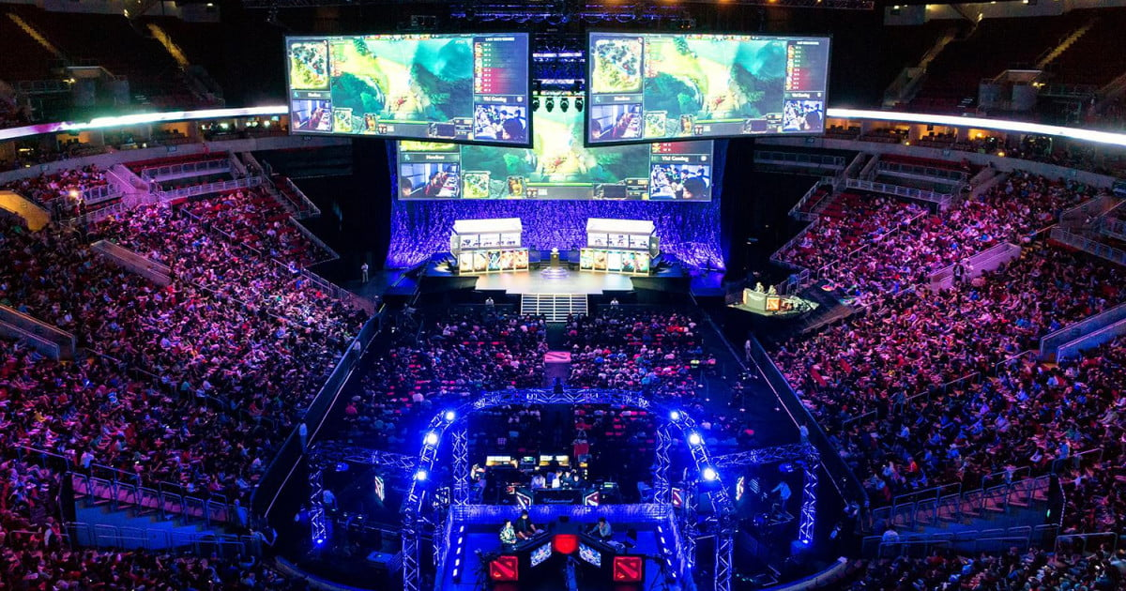
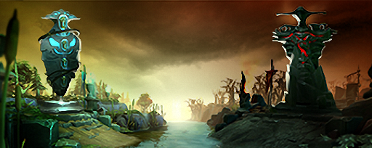
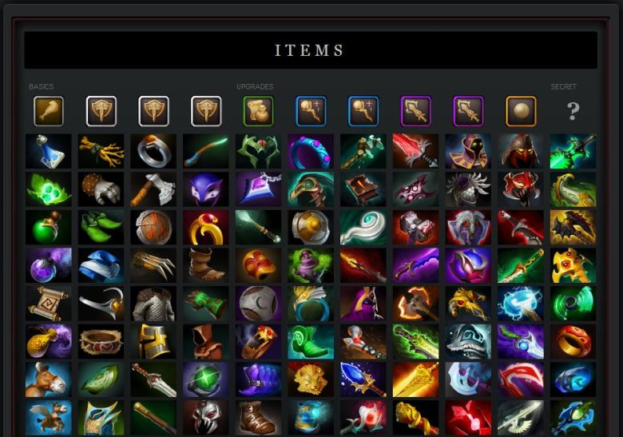
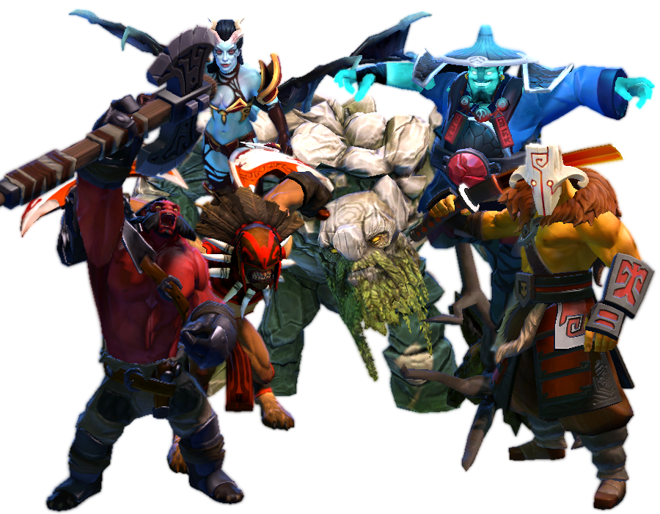

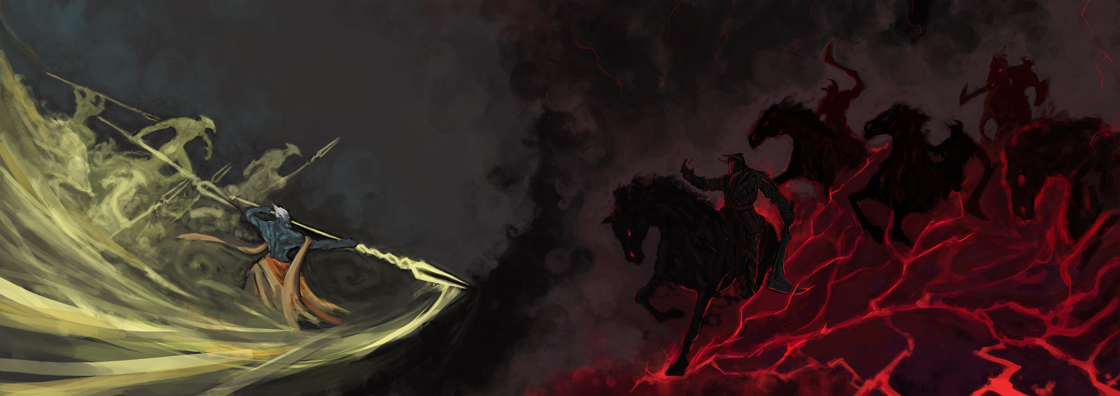
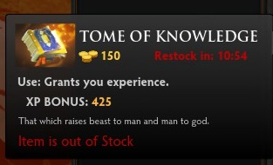
Some background of the game
Team game (5 each)
Lots of characters
Lots of Items
Lots of resources
Lots of objectives
Lots of money
This Photo by Unknown Author is licensed under CC BY-SA-NC
Notes:
There’s a lot of different aspects and elements to the game of dota 2. I’ll just sweep over some of the main aspects here. In a match of dota, there are 2 teams, radiant and dire. Each team comprises of 5 heroes selected from a pool of 117, no duplicates. If you’re keeping track, that’s almost 90 quadrillion possible combinations. There are over 167 items to be used in game, some of which can be duplicated per player. Over time each player tries to gain gold to help them purchase items, and experience points to get them new abilities to help them in the match. In a match key objectives need to be taken before the opposing team’s base can be invaded and then destroyed for victory. And finally, the game itself is extremely successful, this year’s annual worldwide tournament had a prize pool of over 33 million dollars. And even the regular shmoes like me can make money by betting on games or selling in game cosmetic items.

Slide 3
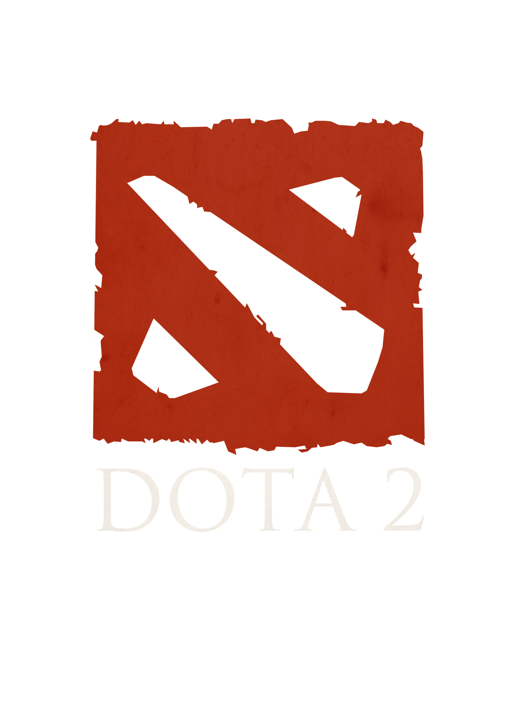
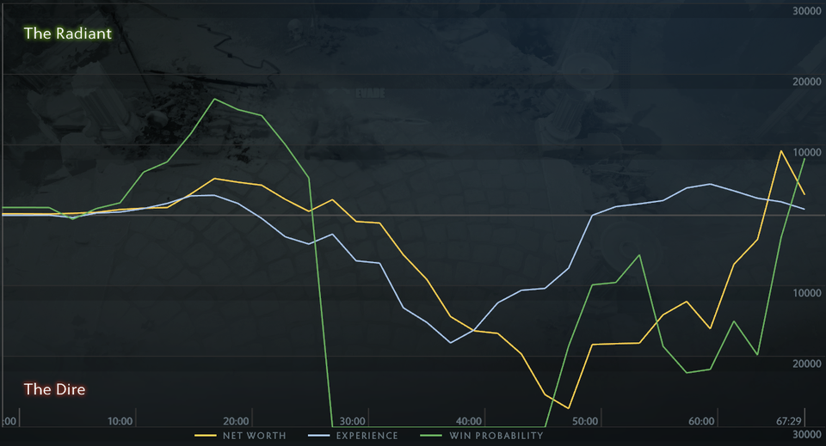
A little bit more background
Notes:
In the game, for subscribers of the feature called dota plus, while players are spectating other peoples’ matches, they have access to nifty graphs like this. The gold line represents the net worth per each team and which one has more. The green line is the win probability of a match. You can see in this match specifically, from around minute 28 to minute 45, the Dire team has a 100% win probability. This basically means that the team could have just sat back and twiddled their thumbs and still won the match. Then you can see the graph climbing back up. Eventually, the Radiant team actually wins. This whole project aims to be more accurate of a predictor of a match before this in game dota plus predictor is. In essence, to create dota plus plus.

Slide 4

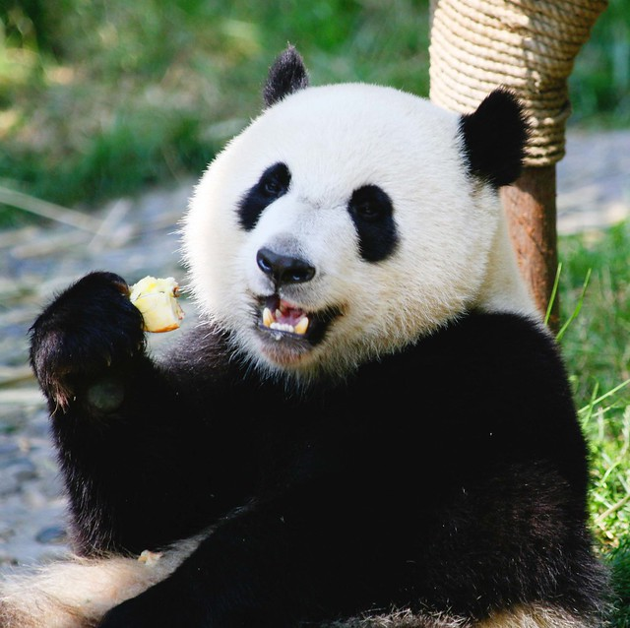


Methodology
Gathered Data from a fan made database “Opendota”
Notes:
I gathered data from a fan created database called Opendota. The condoned gambling site ‘ggbet’ draws data from this site, so I figured it would be good. As for tools I used, I employed a lot of JSON. Sci kit learn to help with machine learning, xgboost for one of the models, and of course pandas for EDA.

Slide 5
What does the data look like?
Team 1 heroes | Team 2 heroes | Items purchased | Objectives taken, Kills | Gold and XP | Radiant Win
Screaming Lady | Balding Dude | Really, really, big knife | We killed a donkey | More than 10, less than a million | Yes
Notes:
Here’s a short summary of what a row of data looks like for my data. The target for this project is radiant win. For some of the features, we have heroes on each side. I have also one hot encoded each purchasable item for each player. The row data also contains Boolean values for if specific objectives have been destroyed during the match. We also have a look at other metrics like net gold worth and experience gained.

Slide 6
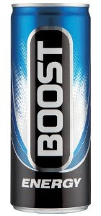
Smashing a model at the data
XGBoost
Random Forest
Notes:
I looked at two models to apply to the data. XGBoost and Random Forest. We’re classifying winners here, and I figured with as many features as I have, somewhere near 2000, these models would be good. They also both contain feature importance, which is a big driver for what I’d like to look at.

Slide 7
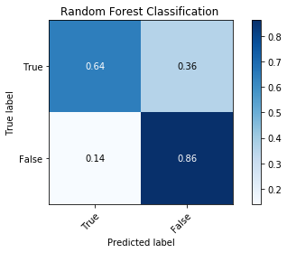
How did the models do?
Average accuracy of .75
F1 score of .75
Most important features
Retaining Specific Objective
Kills on your team
Experience
Notes:
The first model I looked at was Random Forest. Out of the box, it didn’t do too shabby. Then after throwing a grid search at it, I found nice hyper parameters and got the accuracy to about 75%. I chose to look specifically at accuracy because that’s what I set out to beat at the beginning of this project. As you can see, it does pretty well at telling when a team won’t win. According to random forest, maintaining more objectives leads to victory more often, or is more important to keep you team from losing.

Slide 8
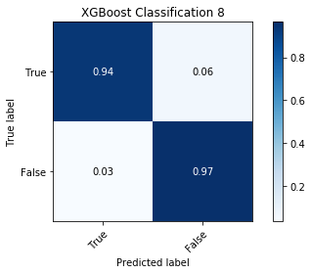
How did the models do?
Average Accuracy of .955
F1 score of .95
Most important features
Last Hits/Denies
Early game items
Gold
Notes:
XGBoost blasted the charts with a whopping .95 accuracy. This persisted even with folding and checking out of sample data. For the xgboost model in general, lane performance was a big factor in terms of winning the match.

Slide 9

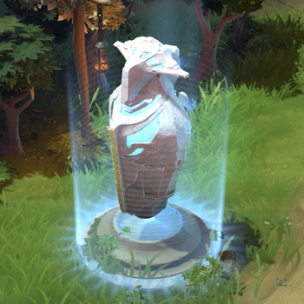
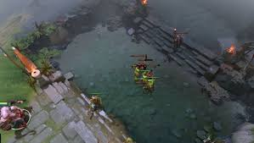
Divide by time
Early (0~15)
Itemization
Lane performance
Objectives
Notes:
I thought something more interesting to look at would be which features are more important at which times of the game. I took my data and divided it into time chunks, then refit models over them. For the early game, winning behavior was dictated by itemization, lane performance and objectives.

Slide 10
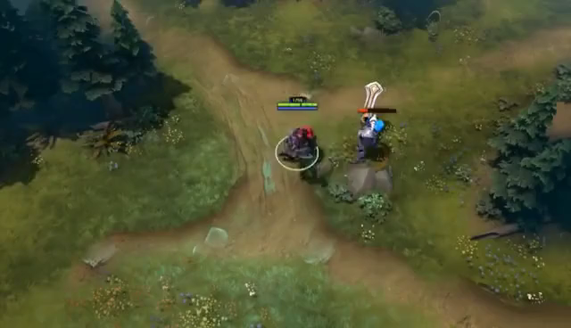
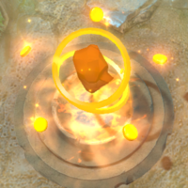
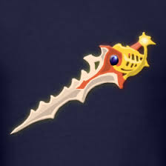
Divide by time
Mid (15~30)
Kills
Gold
Items
Notes:
For mid game behavior, winning was mostly correlated with kills, gold, and items bought with said gold. These features are fairly correlated. So it might be interesting to see what else is here.

Slide 11
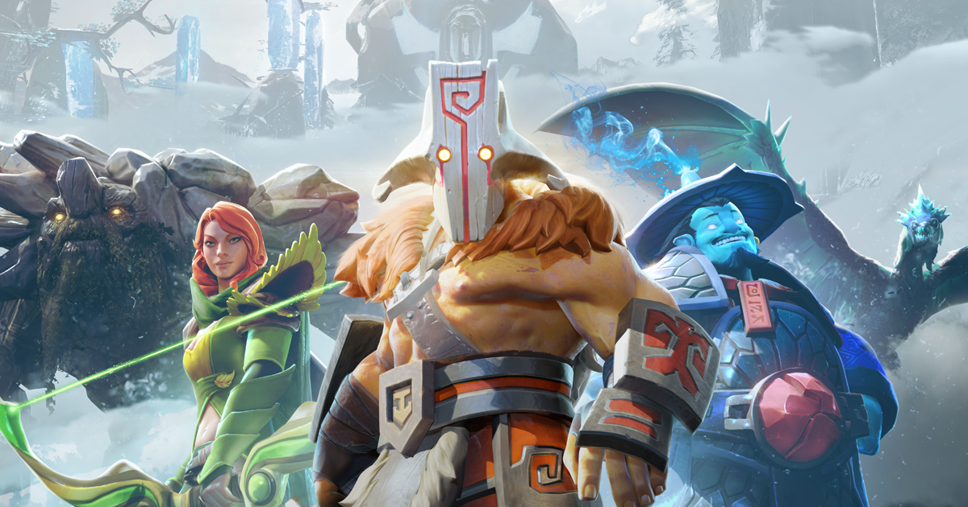
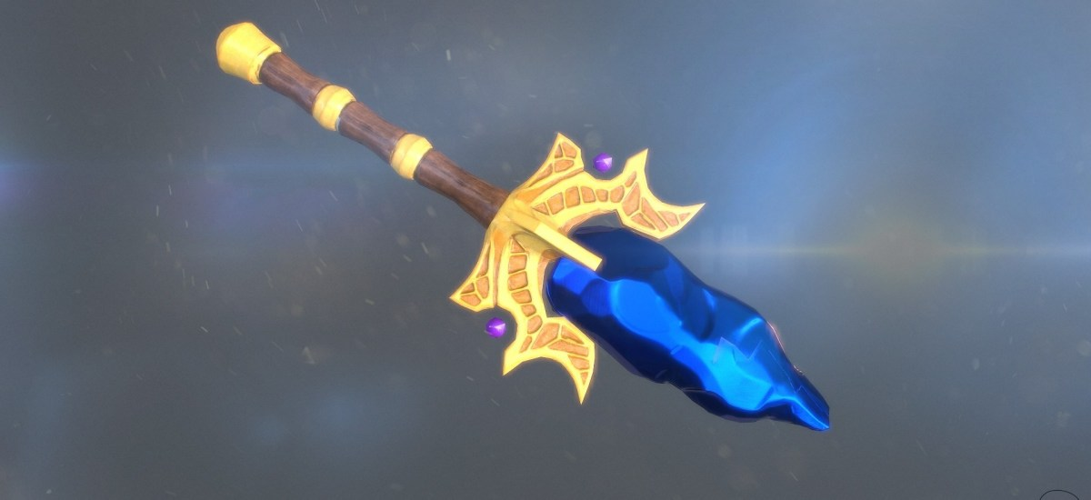
Divide by time
Late (30~)
Hero composition
Gold
Items
Notes:
In the late game, winning behavior is dictated by the hero composition. Some background insight says that there are sometimes heroes that just dominate the late game if they are able to get to that stage. The problem is that getting to this stage is hard for them in the first place.

Slide 12
Next Steps
Get time series predictions going
Ingest more data/ speed up run times
Create flask app
Notes:
As for next steps, I’d like to apply these prediction values to my data and eventually run time series on it. I would also like to employ the use of pyspark to speed up data usage and manipulation, which might allow for better deployment in the future. Finally, I would like to create an app which could help players improve their skill.

Slide 13
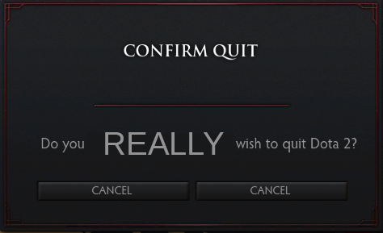
Notes:
That’s almost it I have for this presentation.

Slide 14
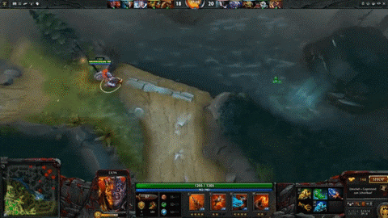
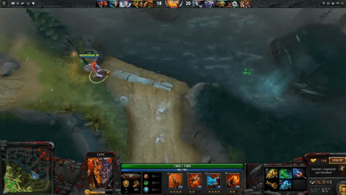
A little bit more background
Notes:
So you might be wondering if I ended up doing better than the in game predictor. The answer is I don’t know. See, there’s currently no recorded data I can attain about dota plus rankings on their own.

Slide 15
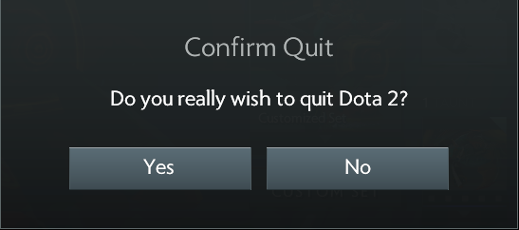

Notes:
That’s all I have for this presentation, thank you.

Slide 16
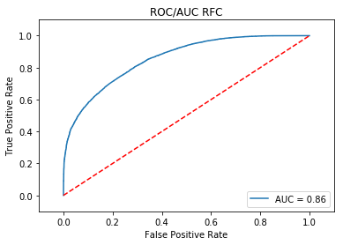
Appendix

Slide 17
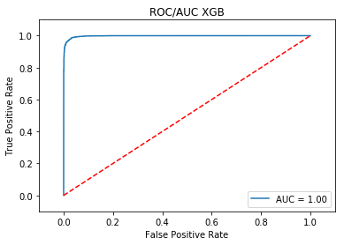
Appendix

